Slide 1

Data analysis from MovieLens
Yixin Luo
Dekun Geng
Haowen Zhu
Yin Hang
Weijing Li

Slide 2
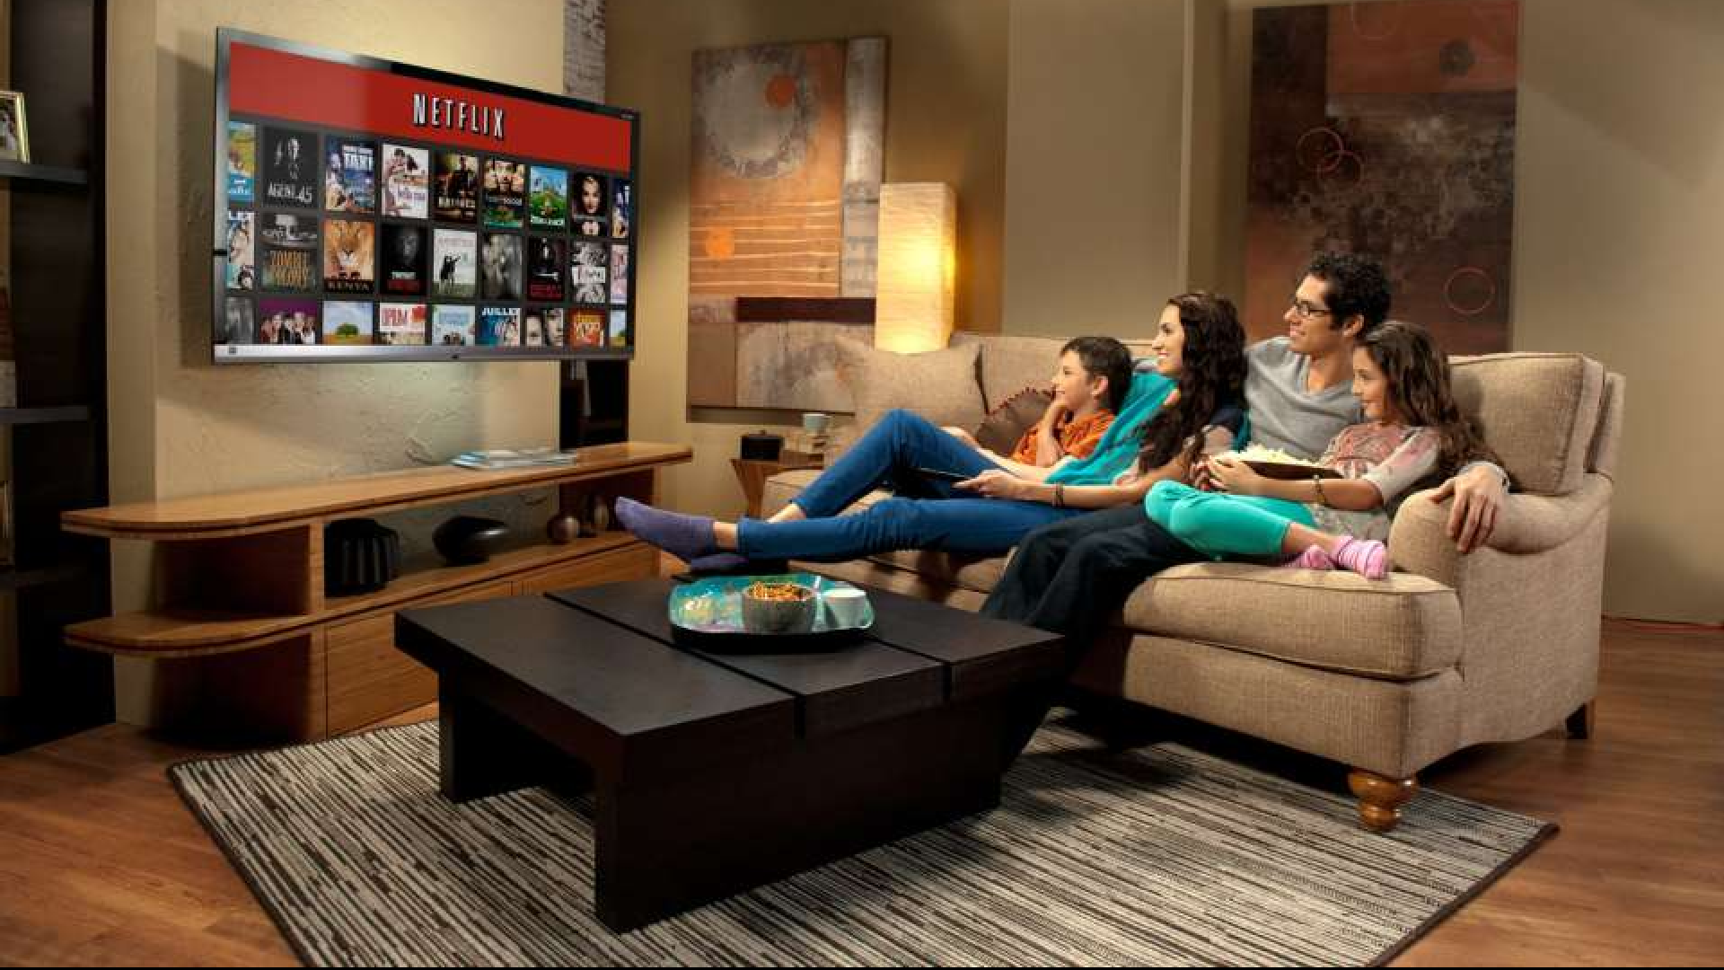

Motivation
Analyze the dataset obtained from Movielens, make some reasonable conjectures, support or refute those conjectures with data.
The essential goal is to give customers better recommendations of movies they will like.

Slide 3
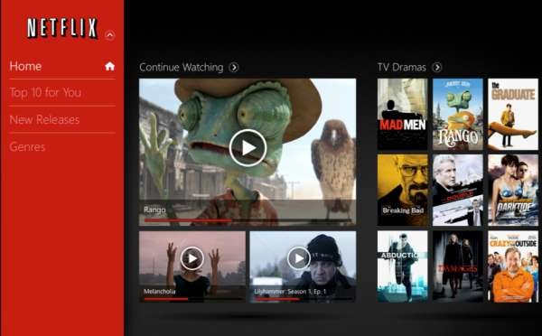
Content
1.Basic details of the data
2.Visualization of the data
3. Correlations of the data
4. Business Analysis

Slide 4

Basic details of the data
1. Ratings：1,000,209 anonymous ratings
2. Movies： approximately 3,900 movies
3. Users: 6,040 MovieLens users

Slide 5

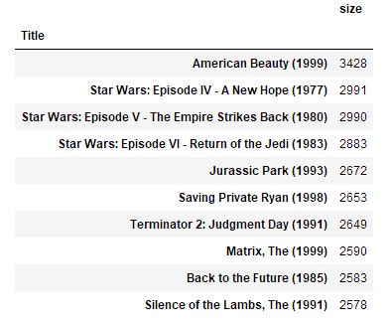
Popularity analysis of the data
Ten most popular movies
(The times of being rated can represent the popularity)

Slide 6

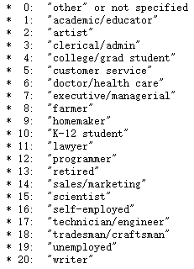
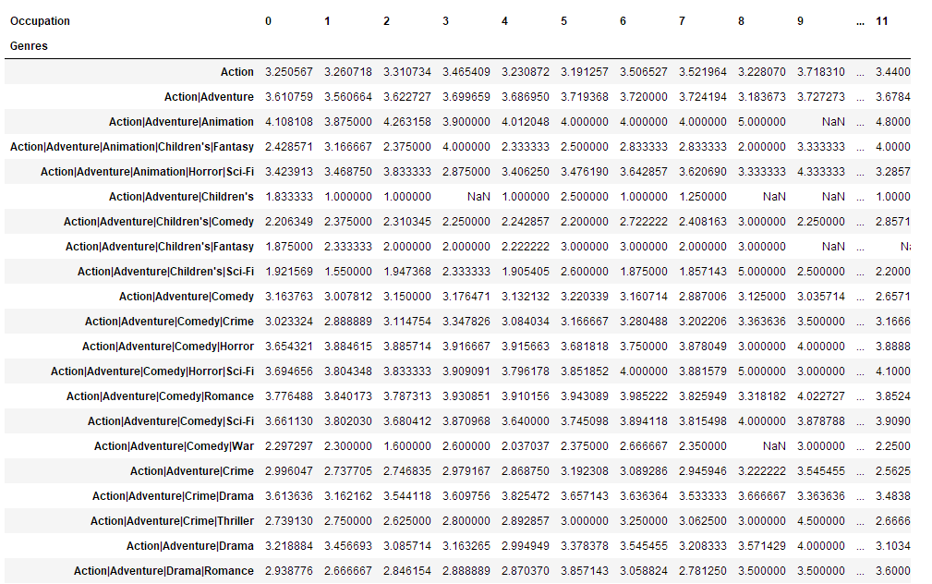
Conjecture of how easy various groups are to please The average ratings from different groups of occupations for different genres

Slide 7
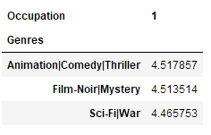
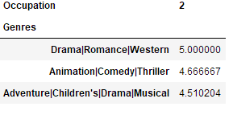
Conjecture of how easy various groups are to please The top three ratings for genres
Recommend the movies of top three genres to the uses

Slide 8
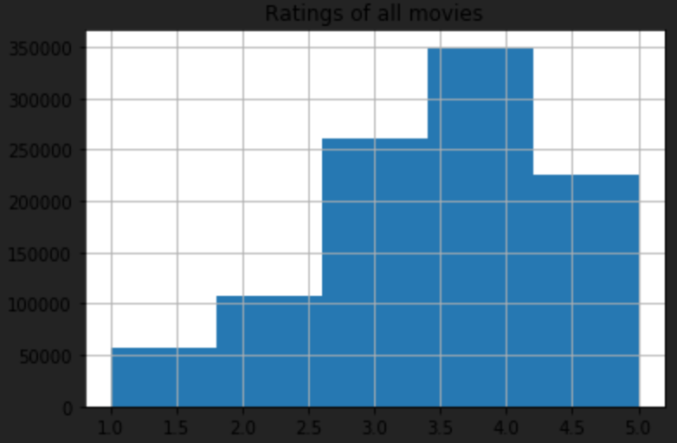
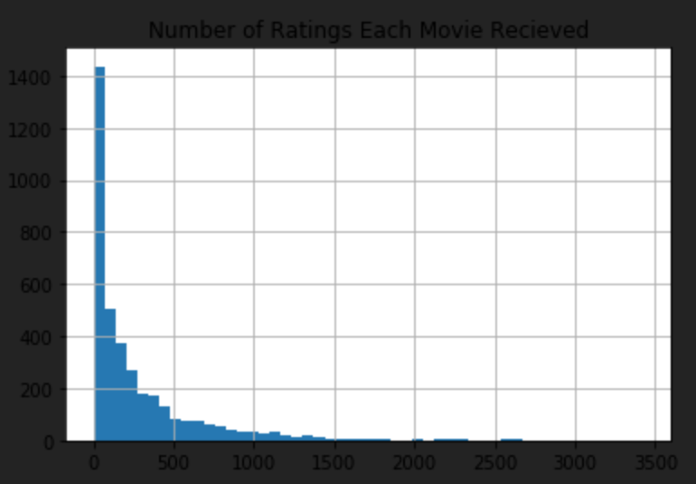
Visualization of the data
the ratings of all movies
the number of ratings each movie received

Slide 9
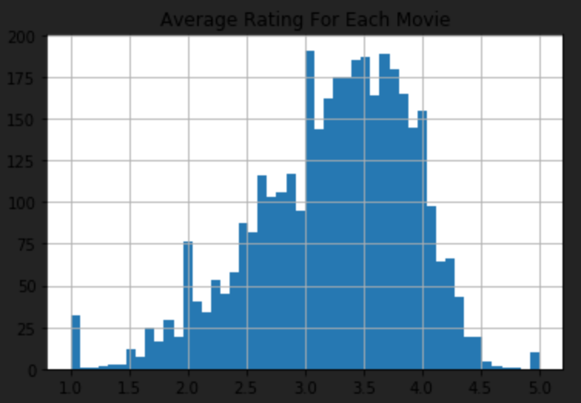
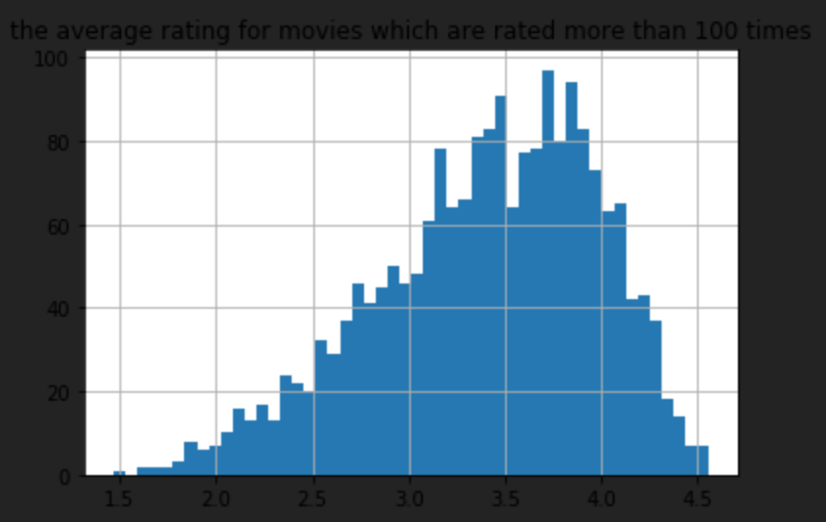
the average rating for movies
which are rated more than 100 times
the average rating for each movie

Slide 10
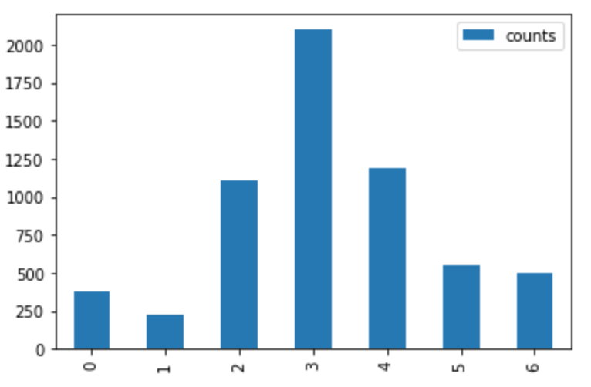
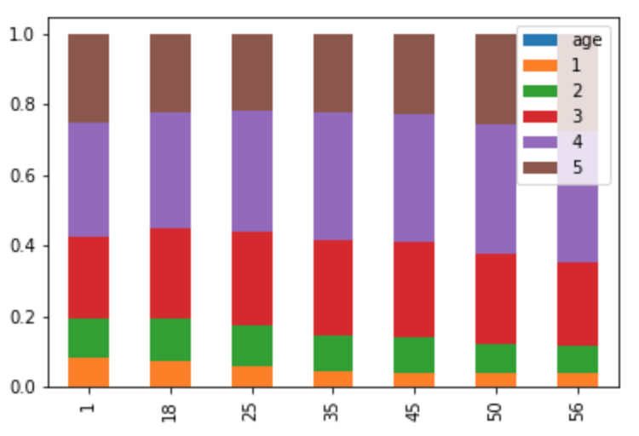
Conjecture about the distribution of ratings:
the correlation between age and ratings
Number of each age group
ratings in each age group
Question: the difference in the right graph maybe caused by multi-variables

Slide 11
Conjecture about the distribution of ratings:
the correlation between age and ratings
ANOVA:
Genres: Action, Thriller and Horror
Gender: Male group
Occupation: couldn‘t be controlled, since it is highly correlated by age group
F-test results:
 | F | P
Action | 19.4254644586 | 1.15745729e-22
Thriller | 11.9257343056 | 2.13378572e-13
Horror | 13.1058496182 | 7.37606168e-15

Slide 12
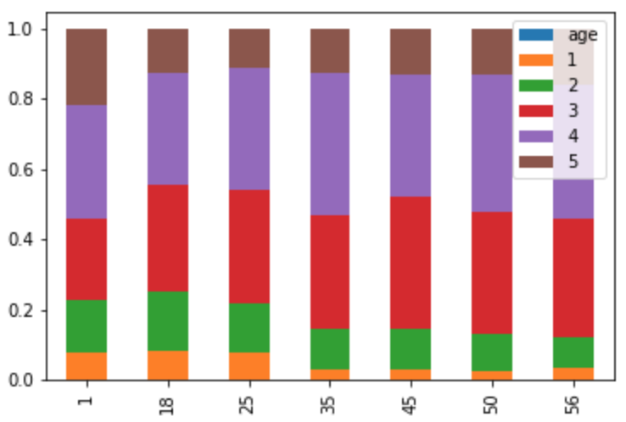
Conjecture about the distribution of ratings:
the correlation between age and ratings
None-controlled variable
Controlled variable (Action & Male)

Slide 13
Correlations of the data
1. Correlation: Men versus women
2.Conjecture for better prediction

Slide 14
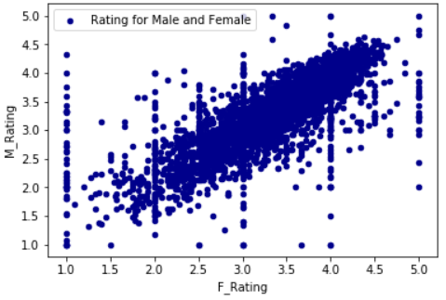
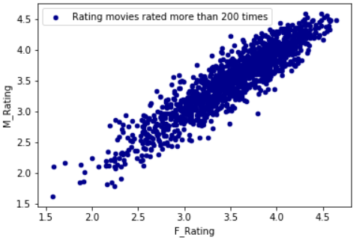
Scatter plot
rating for every movie
rating for movies rated more than 200 times

Slide 15
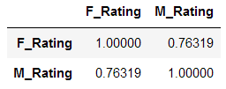
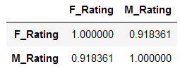
Conjecture for better prediction
correlation coefficient for every movie
correlation coefficient for movies rated more than 200 times
The coefficient increases from 0.76319 to 0.918361 men and women are more similar when they are rating for the movies with large ratings.

Slide 16
Business Intelligence
1. Explore the popularity and performance of different genres
2. Explore users’ taste and preference
3. Recommender system

Slide 17
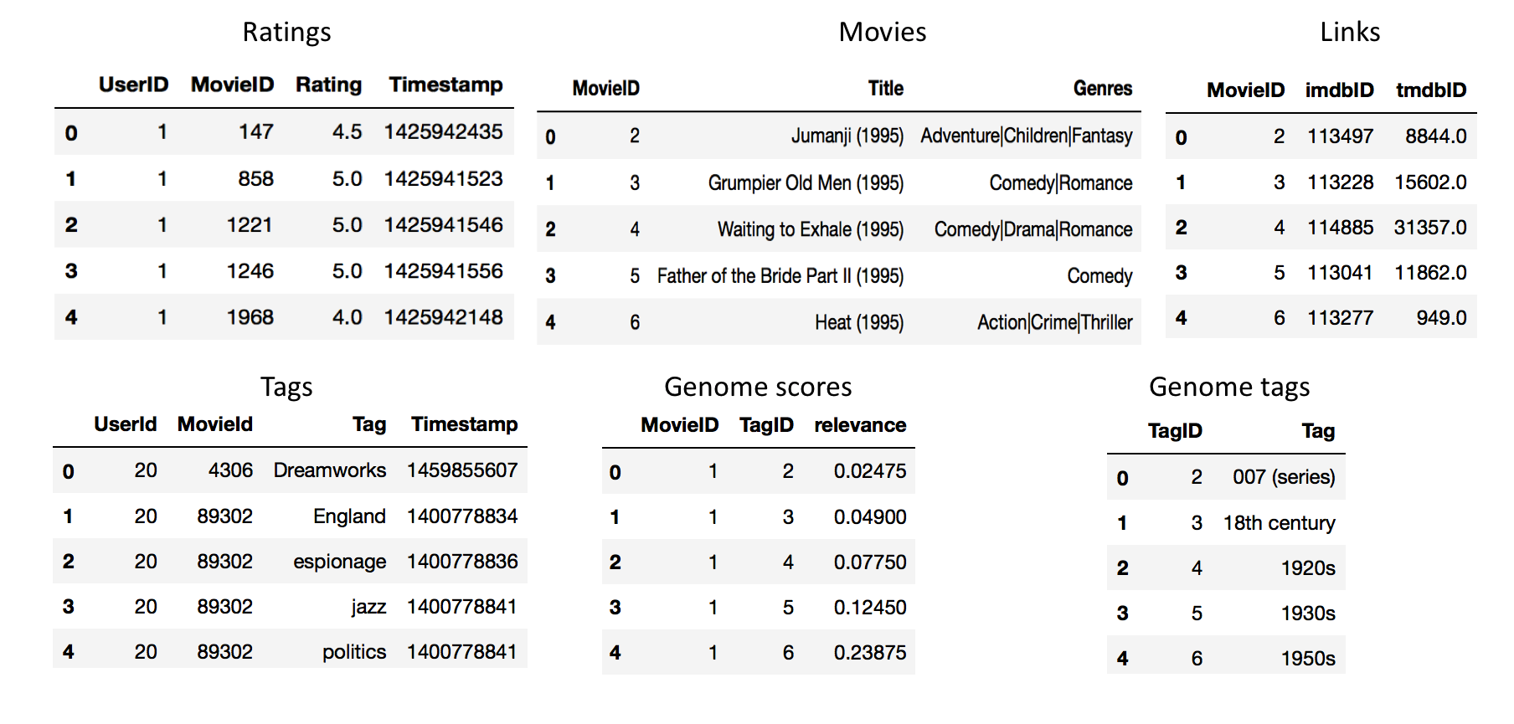
Explore Different Genres
Data Cleaning

Slide 18
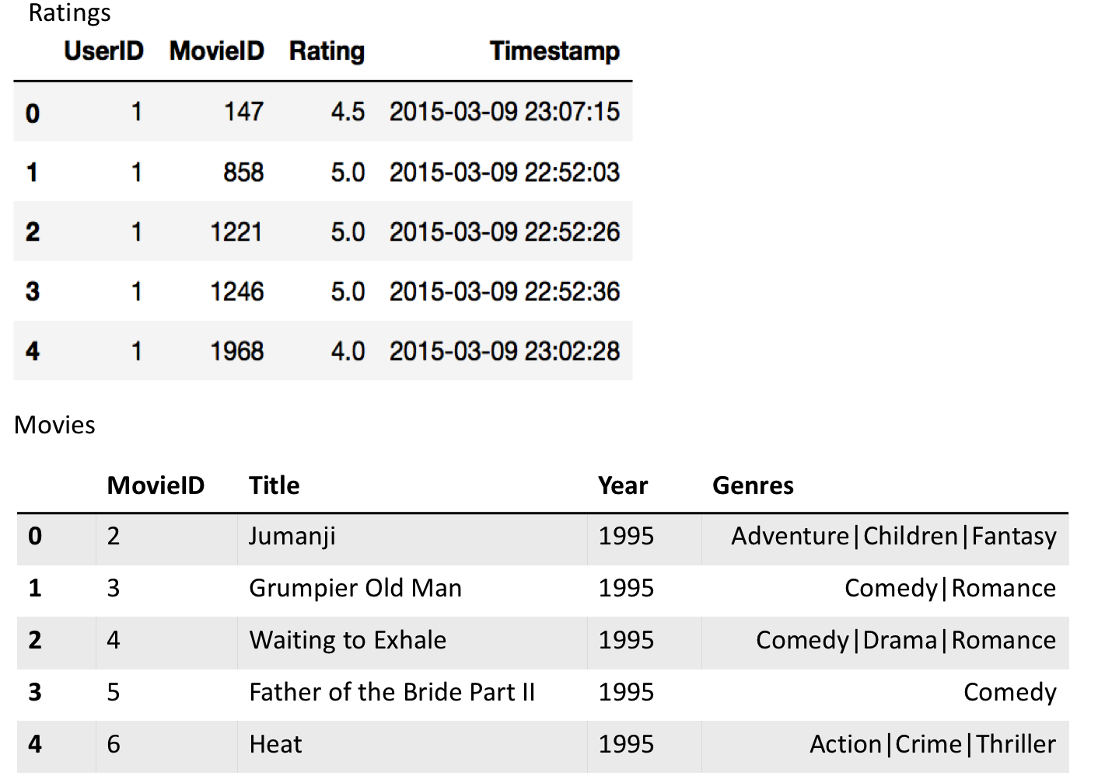
Explore Different Genres - Data Cleaning
Timestamp and split title
Remove missing data: we got 405 missing data with 45852 movies

Slide 19
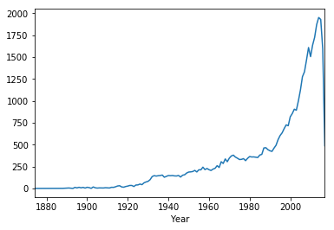
How many movies are made every year?

Slide 20
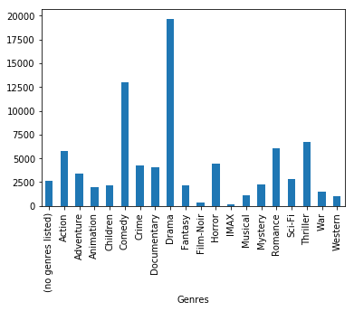
What kind of movie was the most popular year by year?

Slide 21
See it in Different Year

Slide 22
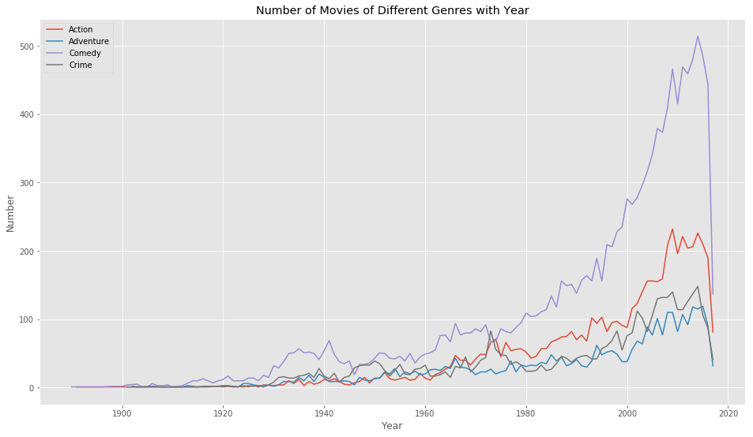
See it in Different Year

Slide 23
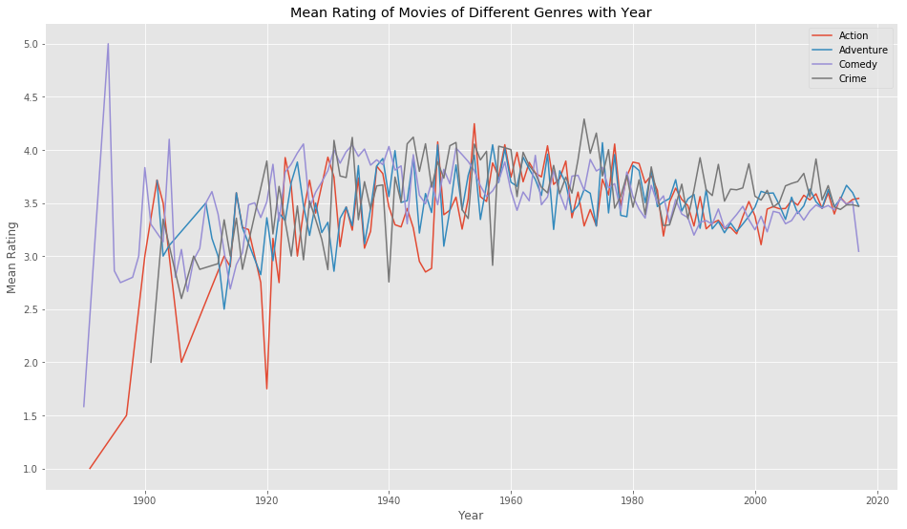
What kind of movie was the best year by year?

Slide 24
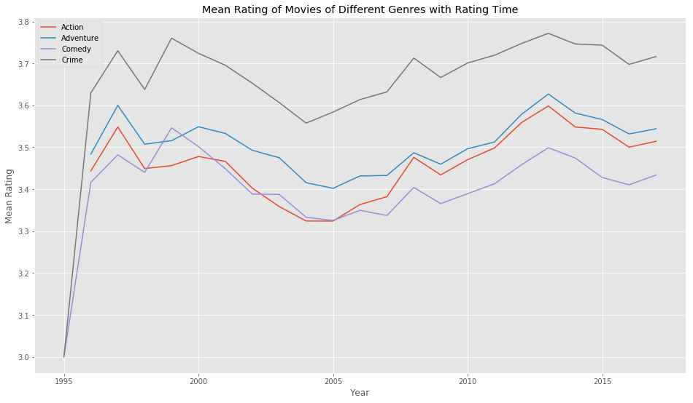
What kind of movie is people get interest in year by year?

Slide 25
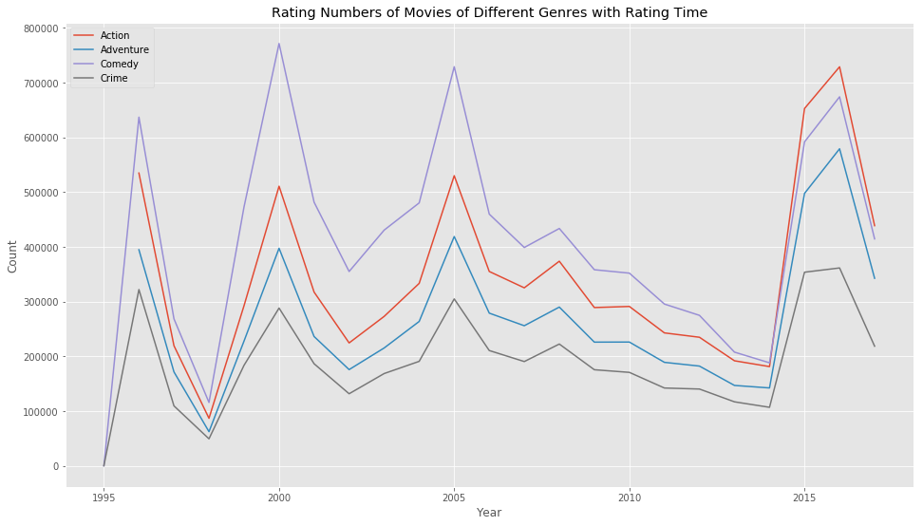
What kind of movie is people get interest in year by year?

Slide 27
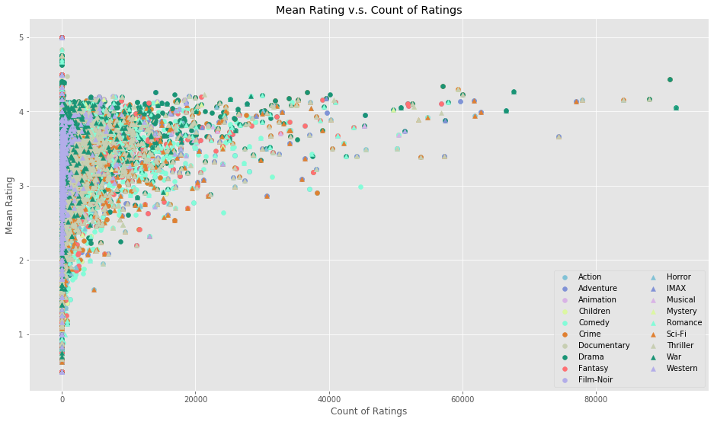
What kind of movie is popular and rating high?

Slide 28
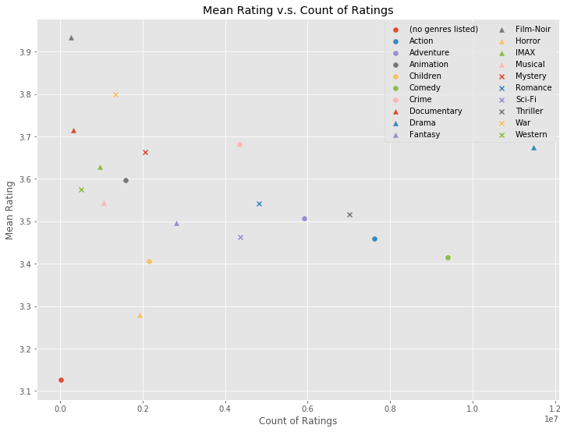

Slide 29
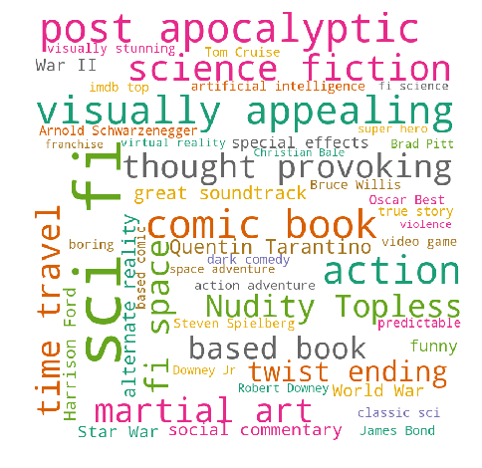
Word Cloud of Different Genre
Simple Frequencies

Slide 30

Word Cloud of Different Genre
Adjusted Frequencies
Using relevance from genome table

Slide 31
Word Cloud of Different Genre
Adventure
Comedy
Crime

Slide 32
To choose a film or a script
For choosing a film or a script, we can :
Choose Crime, Romance, Adventure, Thriller for a conservative choice.
Choose Sci-Fi, Action, Comedy if you are confidence for the script. These genres have a great market space to succeed
Choose a combination of popular genres and unpopular genres with high average ratings which shares a lot common from the word cloud.

Slide 33
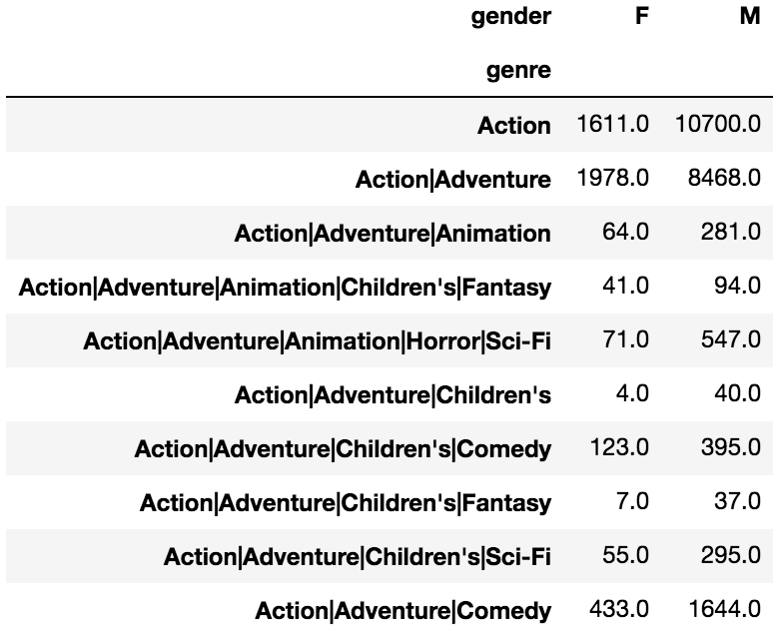
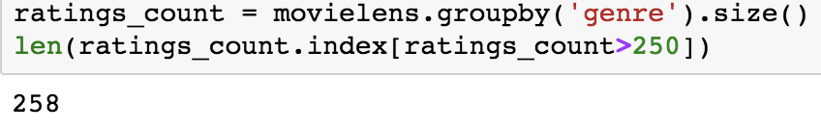
Explore Gender Preference for different film genres
Just use those genres with sufficient views, let's just get those genres which have at least 250 reviews.
Count of ratings for each movie genre

Slide 34
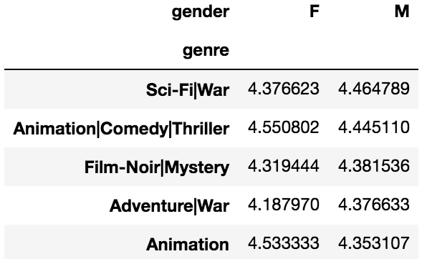
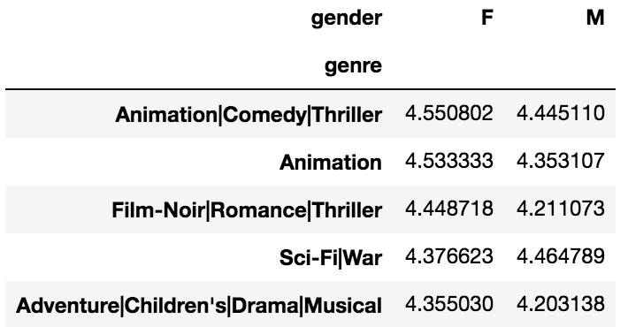
See which genre men and women prefer
Averaged rating ranked by male users
Averaged rating ranked by female users
'Sci-Fi|War', 'Animation|Comedy|Thriller', 'Animation' are all listed in TOP 5 averaged rated genres of both female and male. So, users enjoying a movie would be more inclined to rate a movie, thus this subset of movies with 250+ ratings is slightly more biased than the original total data.

Slide 35
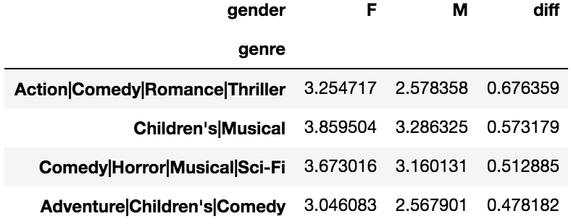
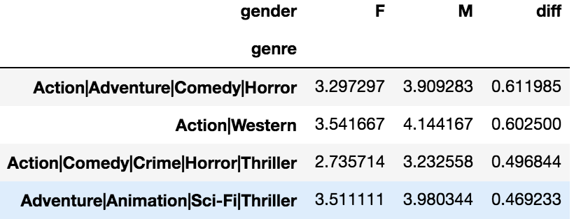
Explore difference between male and female users
Female Preferred than Male
Male Preferred than female
Females and males did not rate different movie genres similarly!

Slide 36
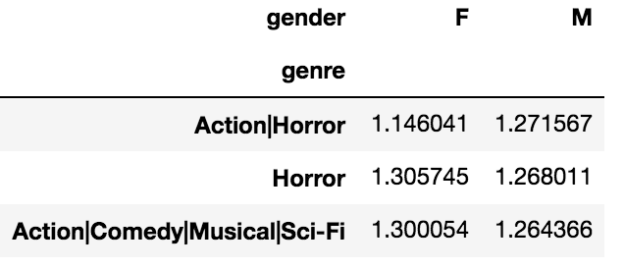
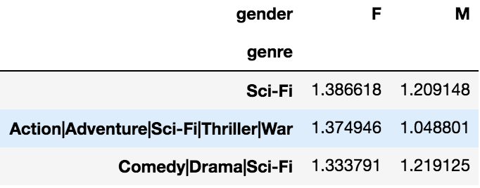
standard deviation
STD for movie genres ranked by male users
STD for movie genres ranked by female users
Another way to measure the differential is through the spread, otherwise known as the standard deviation. For male, 'Action|Horror' took the top prize with the highest standard deviation of 1.271567. Therefore, the ratings male users assigned to 'Action|Horror' movies differed more among each other than for other genres; For female, 'Sci-Fi' undoubtly ranked the TOP 1 movie genre with the highest standard deviation of 1.386618.

Slide 37
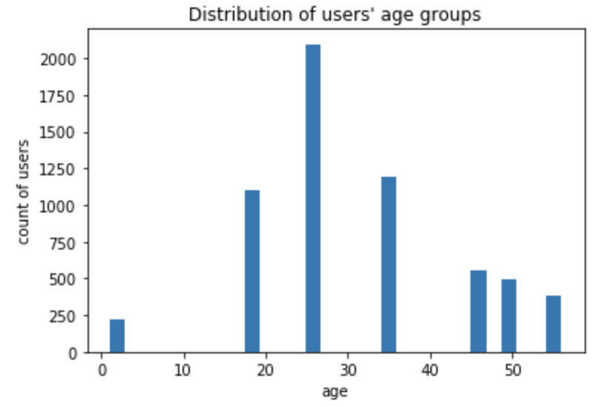
Explore Ratings among different age groups

Slide 38
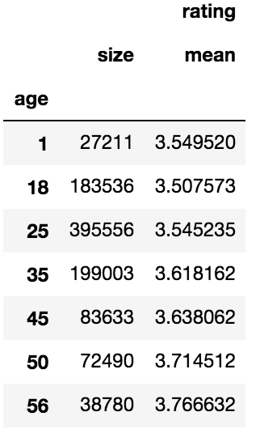
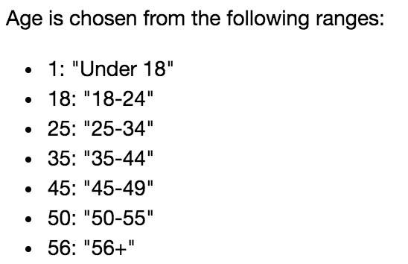
Size and averaged rating for different age groups
Young users seem a bit more critical than other age groups.

Slide 39
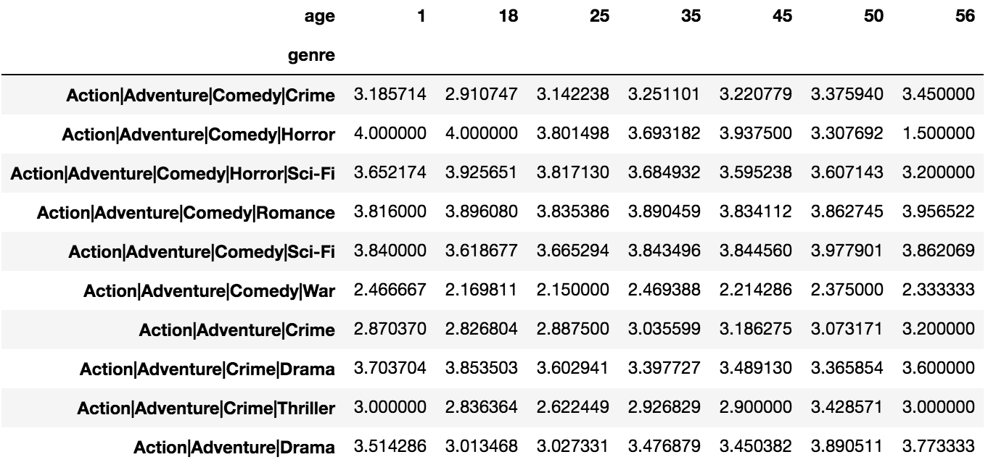
Explore Ratings among different age groups

Slide 40
Recommender System using Matrix Factorization
Low-Rank Matrix Factorization via Singular Value Decomposition：
Matrix factorization is the breaking down of one matrix into a product of multiple matrices. It’s extremely well studied in mathematics, and it’s highly useful.
So what is singular value decomposition (SVD)? At a high level, SVD is an algorithm that decomposes a matrix R into the best lower rank (i.e. smaller/simpler) approximation of the original matrix R. Mathematically, it decomposes RR into two unitary matrices and a diagonal matrix.
To get the lower rank approximation, we take these matrices and keep only the top k features, which we think of as the k most important underlying taste and preference vectors.

Slide 41
Recommender System
Set up ratings data
Import raw ratings data
Normalize and format ratings matrix
Make Predictions
Singular Value Decomposition
Making predictions from decomposed matrices
Make Recommendations
Return the movies with highest predicted rating that the user had not seen yet

Slide 42
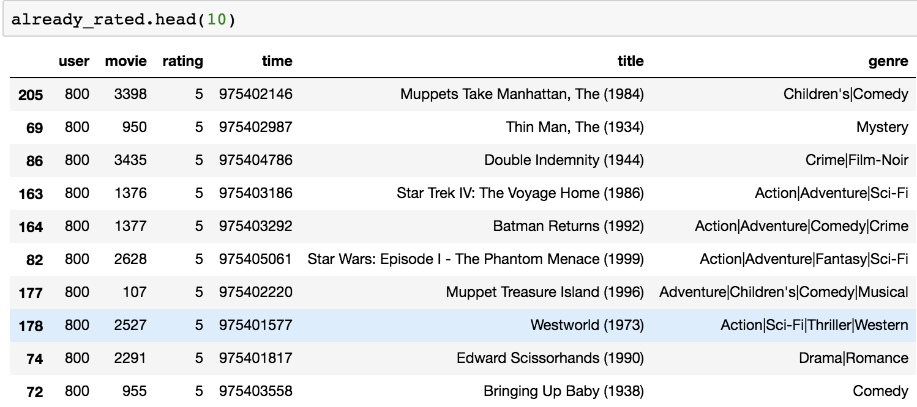
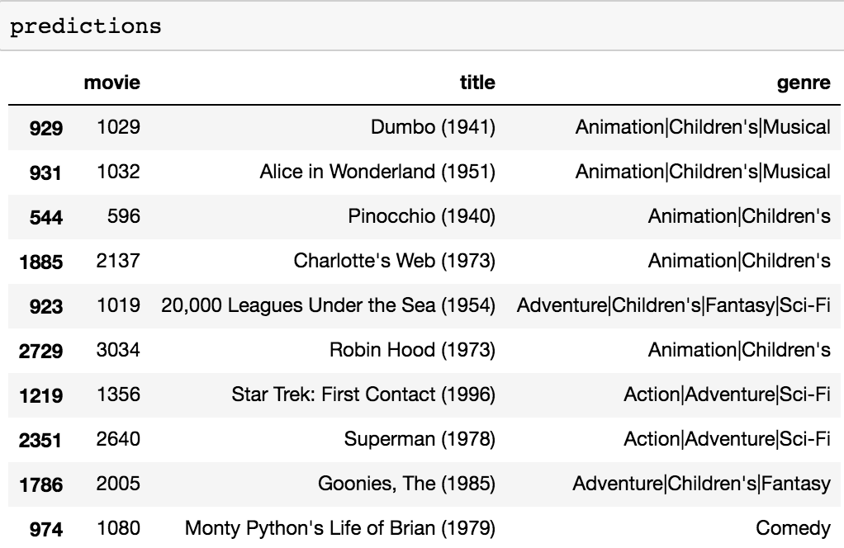
Predict Users’ possible 5-star rating movies
Ten movies that UserID 800 has rated
Possible high rating movies prediction

Slide 43
Business Plan
For any movie companies, when they produce new movies, before they do marketing strategy decision making., it’s important to find their target fans .
Our exploration of gender and age group preference for different movie genres will help movie companies to know their target high-rating users in general and make specific strategy for them.
We build such recommendation system to predict potential high rating movies that users have not rated yet. Movie companies can find users' individual taste or preference for the films and make particular marketing strategy for them. In this way the company could save a lot of money in advertising and achieve "precision marketing" which is the best approach to do data-driven business decision.

